Slide 1
INTRODUCTION TO INTELLECTUAL PROPERTY RIGHTS

Slide 2
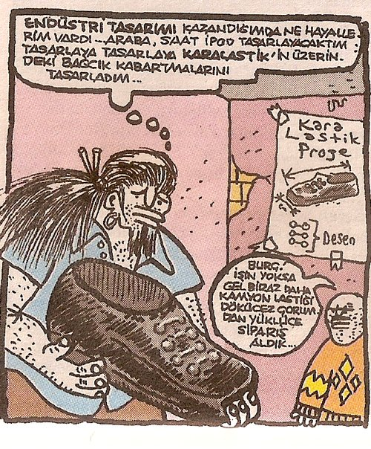

Slide 3
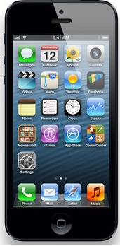

Intellectual Property?
TRADEMARK (MARKA)
PATENT
COPYRIGHT (TELİF HAKLARI)
TASARIM (DESIGN)
TRADE SECRET (TİCARİ SIR)
VS.

Slide 4
How the markets work?
Whenever a new product is successful on the market, it is very likely that competitors will attempt to make similar or identical products.
The innovator will probably have invested significantly in developing the new product, establishing the supply chain for production, running marketing campaigns and finding distributors.
Competitors benefit from these efforts. They have greater market access, a better connection with distributors, and access to cheaper primary resources. As a result they are able to offer their products at a cheaper price.
Innovators are then under heavy pressure and may be driven out of business, while competitors get a free ride on the back of their creativity.
The IP system is there to help innovators protect their inventions, designs, brands, artistic works, and so on. It provides them with ownership over their work and the rights to exclude competitors from the production, import or sale of infringing goods.

Slide 5
How to Utilize IP Rights
Prevent others from making
Use as bargaining chip
License out- license in

Slide 6
IP RIGHTS
RIGHTS ON LITERARY AND ARTISTIC WORKS
INDUSTRIAL PROPERTY RIGHTS
COPYRIGHT
RELATED RIGHTS
PATENT
UTILITY MODEL
DESIGN
TRADE SECRETS
TRADE NAMES
TRADE MARKS
COMMERCIAL TITLES
DOMAIN NAMES
GEOGRAPHICAL INDICATIONS

Slide 7
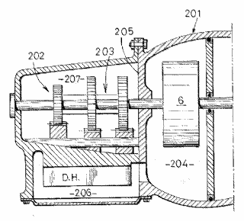


The different types of IP (I)
Legal right
What for?
How?
Patents
New inventions
Application and examination
Utility models
New inventions
Application and registration
Copyright
Original creative or artistic forms
Exists automatically
7
Notes:
7

Slide 8



The different types of IP (II)
Legal right
What for?
How?
Trade marks
Distinctive identification of products or services
Use and/or
registration
Registered designs
Registered designs
Registered designs
External appearance
External appearance
External appearance
Registration
Trade secrets
Valuable information not known to the public
Reasonable efforts to keep secret
Intellectual Property - Law
8
Notes:
8

Slide 9
Common Features of IPR’s
Abstract nature (Soyut nitelik)
Novelty (Yenilik)
Exclusivity (Engelleme hakkı)
Registration (Tescil)
Territoriality (Ülkesellik)
Exhaustion/First Sale (Tükenme)
Term (Süreye tabi olma)

Slide 10
Abstract Nature
IPR’s are not tangible
A person who owns the tangible property does not have to be (and usually isn’t) the owner of the IPR
Eg.: A person who bought a smart phone has only the right to use the software on agreed terms

Slide 11
Novelty
IPR’s are granted in exchange of new ideas shared with the society
The nature of novelty may differ according to the various forms of IPR’s
Novelty + Inventive step (Patents)
Novelty (Utility models)
Novelty + Individual character (Designs)
Originality (Copyrights)
Distinctiveness (Trademarks)

Slide 12


Right to Exclude
Actions which may be prevented:
Manufacture
Sale
Importation
Use
Possession
Right to exclude does not necessarily mean right to make!!!!!!!!!

Slide 13
Registration
Registration is required for the protection of IPR’s
Exceptions:
Copyright,
unregistered trademarks and designs ( by unfair competition)
Protection and term starts beginning from the application, not registration

Slide 14
Territoriality
IPR’s are territorial
To acquire IP right in a country, the IP right must be registered in that country
Conditions of protection is evaluated by the country for which the registration is sought
International efforts for stretching the principle of territoriality
1886 Bern Convention
1883 Paris Convention
Priority right
TRIPS Agreement
International agreements regulating common application
Single international application run by WIPO
Different agreements for different IP forms
Patents-PCT
Trademarks-Madrid
Designs- Hague (Lahey)
Examination run by each country according to its own domestic law
Single common examination system
EPO-EPC
Regional organizations and centralized registration
EU
Designs
Tardemarks
Unitary patent

Slide 15
Priority Right
The priority right allows the applicant to file a subsequent application in another country for the same invention, design, or trademark effective as of the date of filing the first application.
The period of priority, i.e., the period during which the priority right exists, is 6 months for industrial designs and trademarks and 12 months for patents and utility models

Slide 16
Exhaustion of IPR (First Sale)
Once a product protected by an IP right has been marketed with IPR owner’s consent, the IP rights of commercial exploitation over this given product can no longer be exercised by the IPR owner.
Exhaustion types and parallel imports:
National exhaustion
Regional exhaustion
International exhaustion
Right to repair
Repair or manufacture?

Slide 17
Term
IPR protection limited to a certain term.
Patents 20 years
Utility mod. 10 years
Designs 5x5 years
Trademarks 10 years with the opportunity to renew
Copyrights Life+70 years
At the end of the term the IPR falls in the public domain
Some IPR registrations may be renewed

